Slide 1

Week at A Glance for Science
March 15-17
Solar System and Beyond

Slide 2
March 15-17
e. Ask questions to compare and contrast the characteristics, composition, and location of comets, asteroids, and meteoroids.
b. Develop a model to represent the position of the solar system in the Milky Way galaxy and in the known universe.

Slide 3
March 6-10
S6E1. Obtain, evaluate, and communicate information about current scientific views of the universe and how those views evolved.
a. Ask questions to determine changes in models of Earth’s position in the solar system, and origins of the universe as evidence that scientific theories change with the addition of new information. (Clarification statement: Students should consider Earth’s position in geocentric and heliocentric models and the Big Bang as it describes the formation of the universe.)
b. Develop a model to represent the position of the solar system in the Milky Way galaxy and in the known universe.
c. Analyze and interpret data to compare and contrast the planets in our solar system in terms of: • size relative to Earth, • surface and atmospheric features, • relative distance from the sun, and • ability to support life.
d. Develop and use a model to explain the interaction of gravity and inertia that governs the motion of objects in the solar system.
e. Ask questions to compare and contrast the characteristics, composition, and location of comets, asteroids, and meteoroids.

Slide 4
 | Monday 13 | Tuesday 7 | Wednesday 8 | Thursday 9 | Friday 10
Focus Standard(s) | No School | No School Power Up (work from home) | S6E1.e | S6E1.e,b | S6E1.e,b
Learning Target(s) |  |  | Comets and Asteroids | Comets and Asteroids | Milky Way Galaxy
Opening |  |  | Game: Asteroids | WB Chapter 20 | WB Chapter 20
Work Session |  |  | Solar System; comets and asteroids; draw size of planets | Solar System; comets and asteroids; draw size of planets | Solar system; Milky Way Galaxy; Comets and Asteroids; size of the planets
Closing |  |  | TOD | Think-Pair-Share | Class Discussion
Minor Assignments Due |  |  |  |  | Quiz
Major Assignments Due
Current Relearning & Reassessment Assignments (with due dates) |  | Continue to collect missing graded assignments
Vocabulary
Upcoming Major Assignments |  | Science Fair Projects Due by March 10

Slide 5
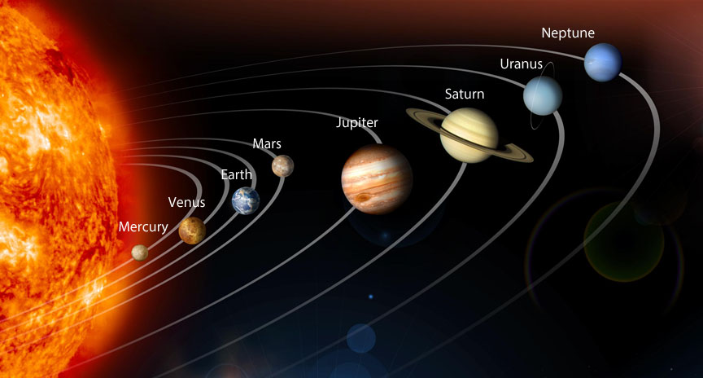

Slide 6
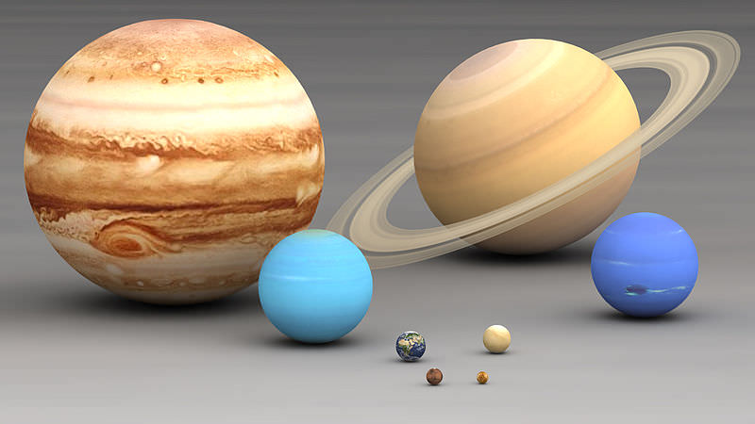
Relative Size

Slide 7
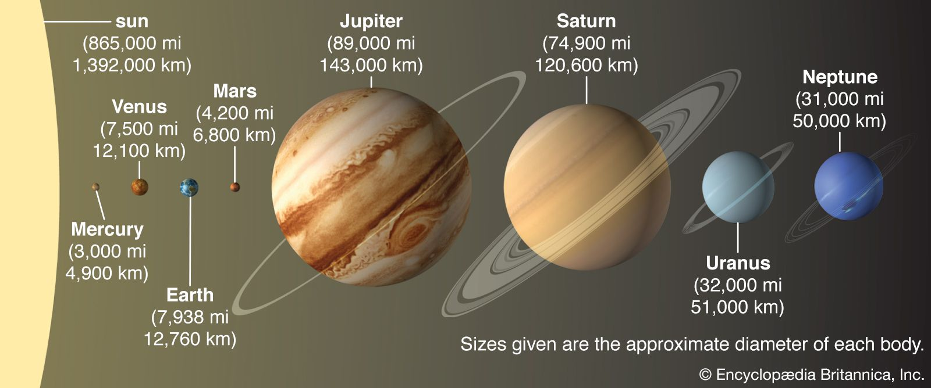
Relative Distance

Slide 8
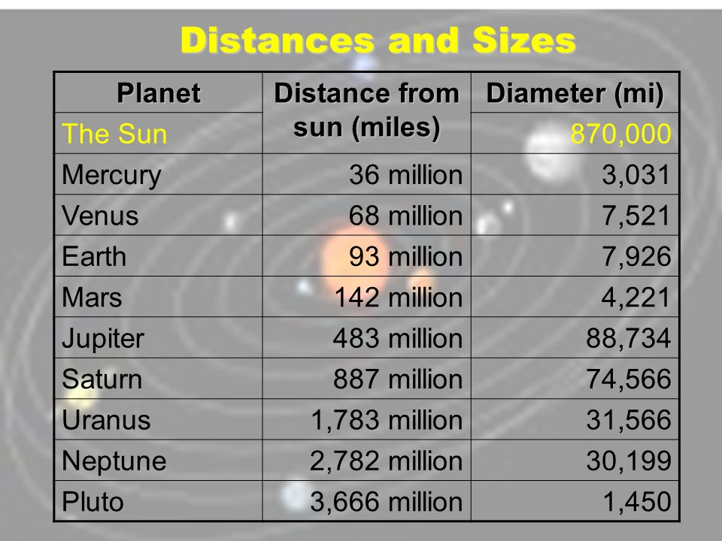

Slide 9
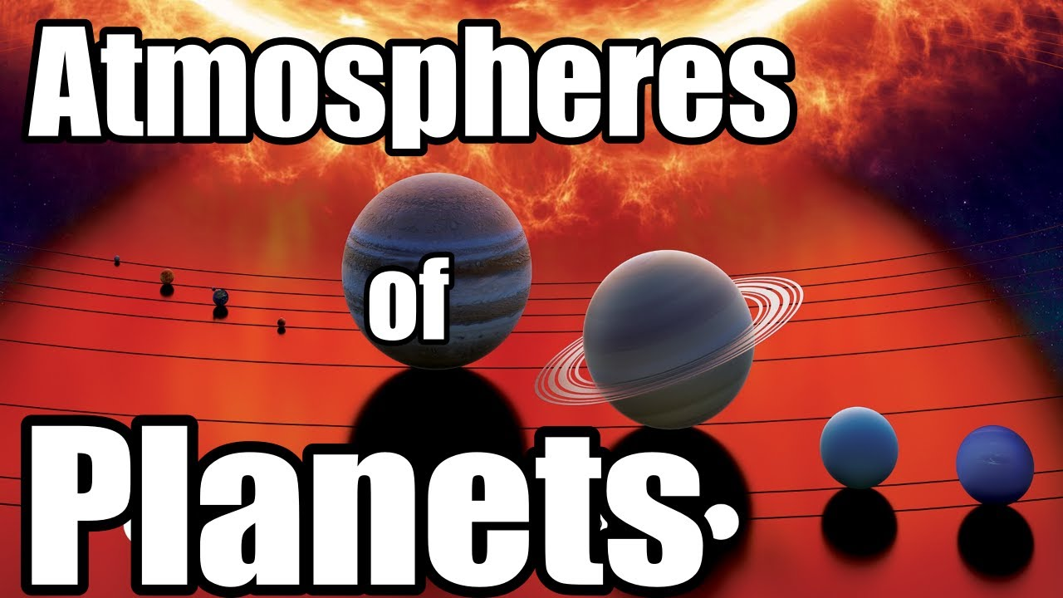

Slide 10
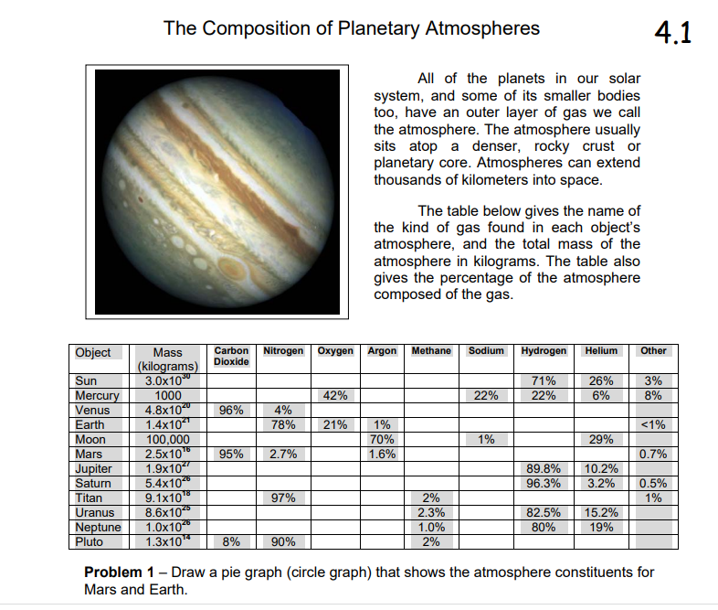

Slide 11
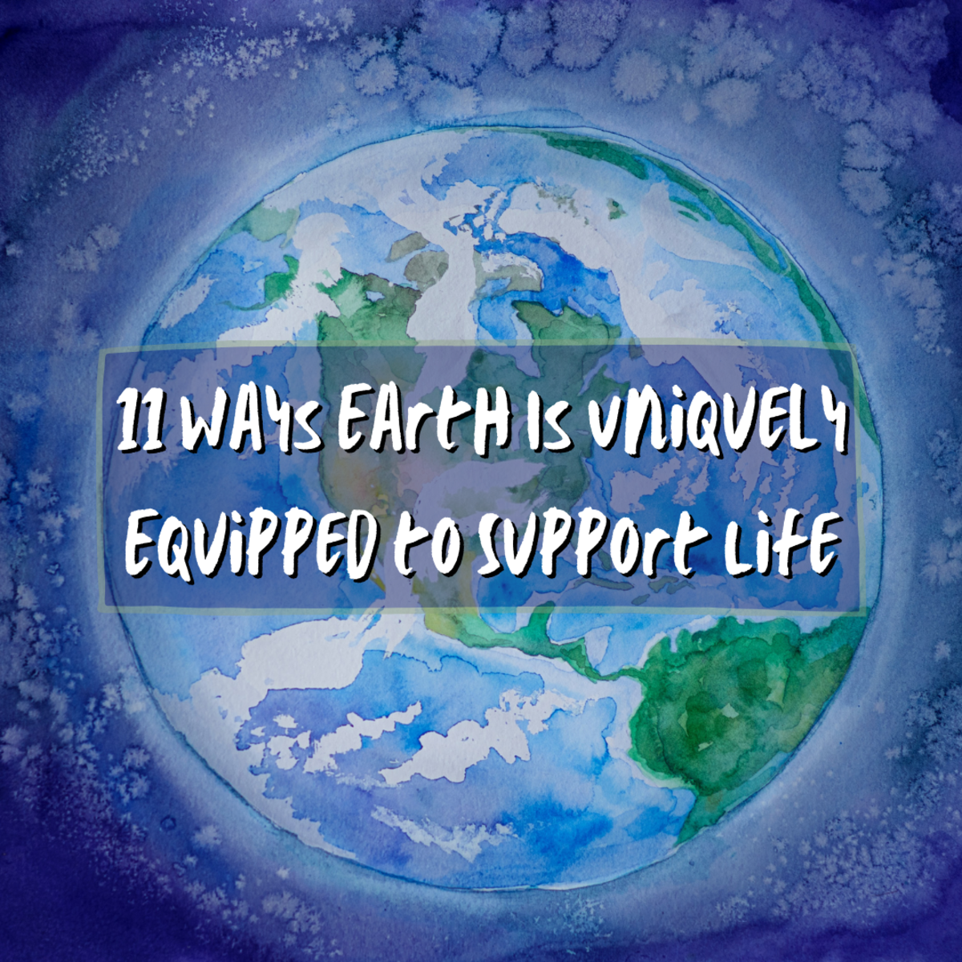
Ability to Support Life

Slide 12
Incredible Facts About The Planets In Our Solar System | Zenith Compilation | Spark
Click for video

Slide 13
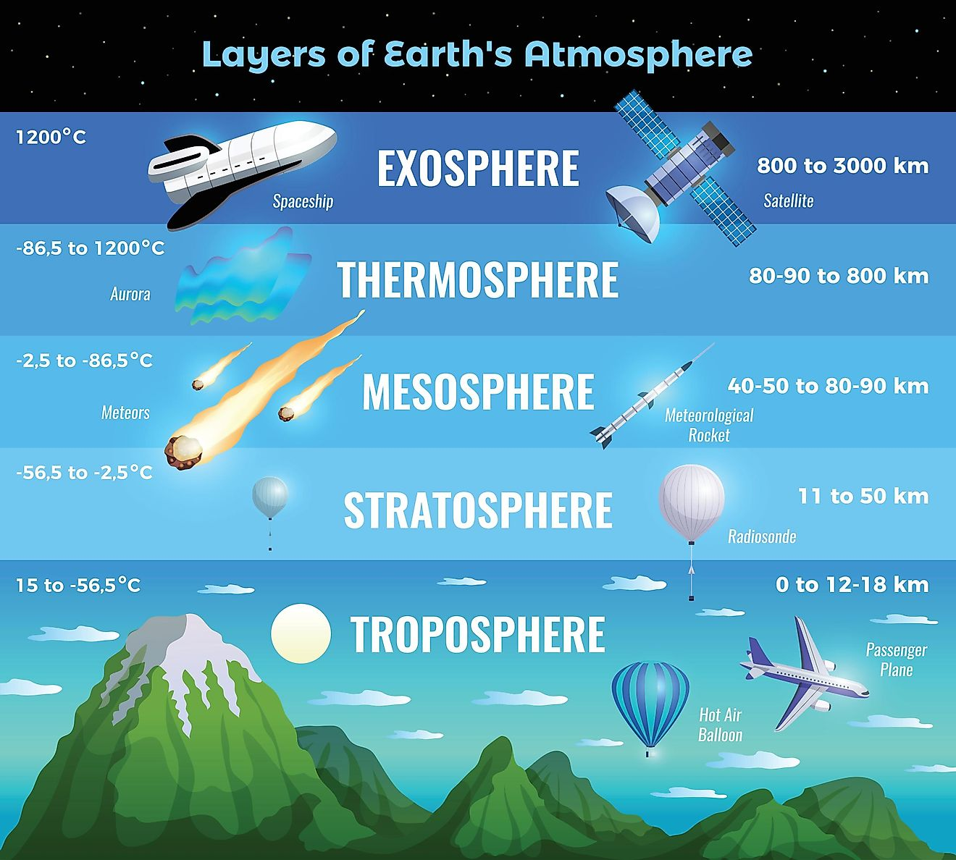

Slide 14
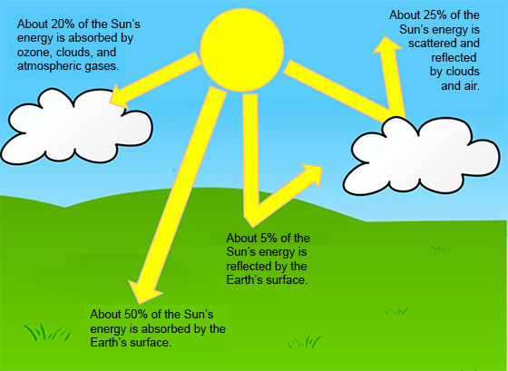

Slide 15
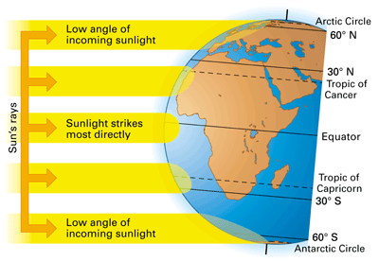

Slide 16
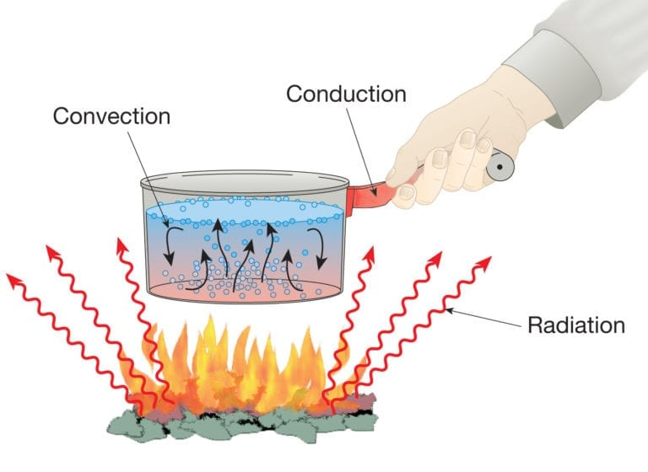

Slide 17
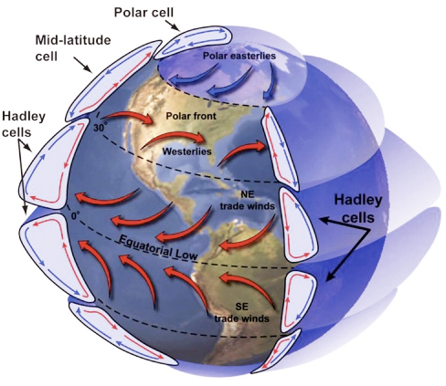
Global Wind Explained
The illustration below portrays the global wind belts, three in each hemisphere. Note that the U.S. lies primarily in the Westerly Wind Belt with prevailing winds from the west. Each of these wind belts represents a "cell" that circulates air through the atmosphere from the surface to high altitudes and back again. The cells on either side of the Equator are called Hadley cells and give rise to the Trade Winds at Earth's surface. How do we explain this pattern of global winds and how does it influence precipitation?

Slide 18
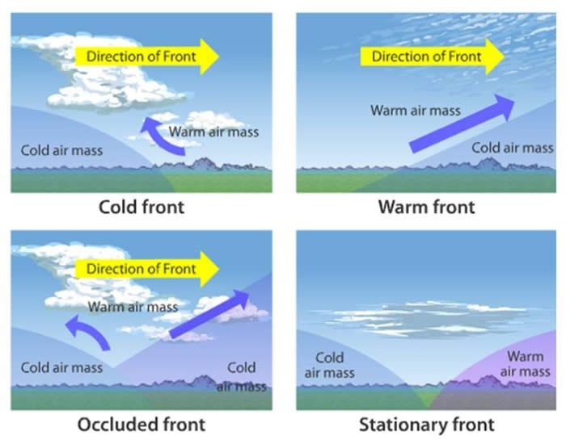

Slide 20

Students will have 15 minutes of Homework each evening.
4 Squares (usually a drawing)
Rock Cycle Puzzle
Workbook Pages
Powerpoint Study Guides
Study Notes or Study Guides
Watch Videos from Week at a Glance

